Slide 1
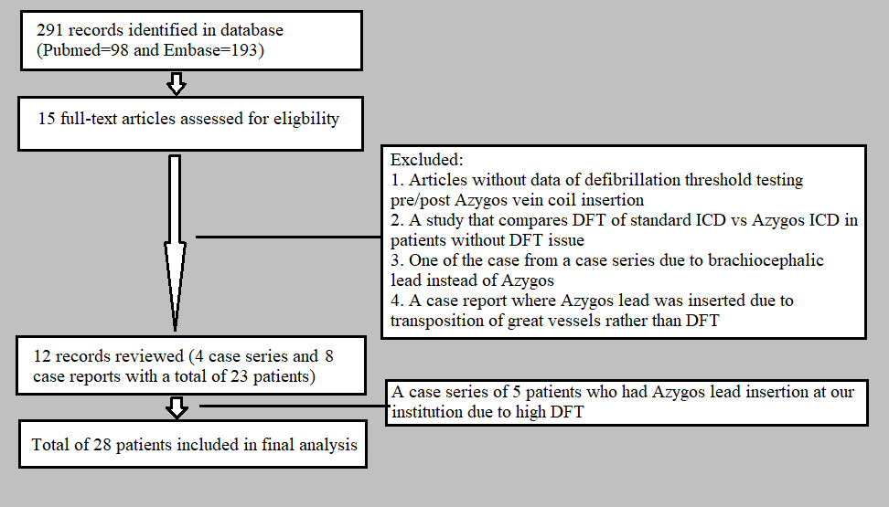
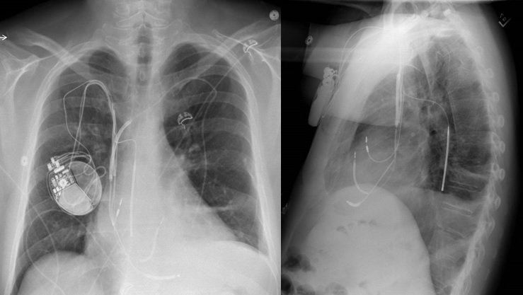
A Systematic Review and Single Center Experience of Azygos Vein Defibrillator Lead Insertion
Yang Chi Ying MD¹, Suchith Shetty MD², Ketan Koranne MD² and Michael C. Giudici MD¹
¹Department of Internal Medicine, University of Iowa, Carver College of Medicine; ²Department of Cardiology, MercyOne North Iowa
Background
Study selection process through Preferred Reporting Items for Systematic Reviews and Meta‐analyses
Results
Defibrillation threshold (DFT) testing is performed in individuals with higher predicted risks of defibrillation failure. Many strategies have been explored to overcome the challenge of high DFT including an insertion of defibrillator lead into azygos vein. We performed a systematic review of the literature to evaluate the safety and efficacy of azygos vein ICD lead insertion for high DFT with the experience of the procedure at our institution.
The mean age of the pooled cohort was 47 years (range 17-88).
Males represented 92% of the total cases and average BMI was 34.
The mean ejection fraction was 25%. 78% were non-ischemic cardiomyopathy.
Left axillary or subclavian vein was the common percutaneous access (36% and 48%).
The mean duration of Azygos vein access and lead delivery was 22 minutes (range 13-60).
The average DFT prior to Azygos coil insertion was 35J (range 20-45). 57% of cases achieved substantial (>10J) DFT improvement whereas 18% achieved relative (<10J) improvement compared to the pre-procedural threshold.
No immediate or remote procedure-related complications were reported except in one case where there was lead migration requiring a vascular plug.
During an average follow-up period of 18 months, five patients had ventricular arrhythmic events requiring device therapy and four of them had successful cardioversion from the device. One patient died from cardiac arrest with variable device therapies of both unsuccessful and successful events.
Methods
The literature review was performed in PubMed and Embase from inception to December 2020 to identify all the case-reports and case-series related to azygos vein defibrillator lead insertion. Our search identified 291 records. After excluding the duplicates, studies without DFT thresholds and non-azygos vascular destinations, 12 studies (23 cases) were reviewed from the current database. We also conducted a retrospective analysis of five cases performed at our institution and a total of 28 patients were included in our final analysis.
Clinical characteristics and Outcomes of the pooled cohort for Azygos vein lead ICD
Post-implant Chest X-rays
Age | 47 (17-88)
Gender | 26M, 2F
BMI (kg/m²) | 34 (21-56)
Mean LVEF% | 25 (15-40)
Etiology of heart failure | 22 NICM, 6 ICM
Amiodarone therapy | 5
Left ventricular end-diastolic diameter (cm) | 7.3 (4.5-9)
Percutaneous vascular access | 9 LAX, 12 SC, 1 LF
Duration of Azygos vein access and lead delivery (minutes) | 22 (13-60)
Procedural complication | Lead migration in one case
Maximal DFT tested with prior ICD system | 35J (20-45)
DFT after Azygos lead insertion | 26J (10-41)
ICD discharge after implant | Present in 5 cases and successful in 4
Follow up duration (months) | 18 (4-60)
Conclusion
Azygos vein defibrillator lead insertion is a reasonable option for patients with expected risk of defibrillation failure with a considerable rate of success and lower risk of major complications. Larger studies and longer follow-ups are warranted to establish its efficacy and safety.
ICM = Ischemic cardiomyopathy NICM = Non-ischemic cardiomyopathy
LAX = Left Axillary Vein SC = Subclavian Vein
RSC = Right Subclavian Vein
LF = Left femoral vein

