Slide 1
Echocardiography in Cardio-Oncology when, why and How to image?
Isabella Grumbach, MD, PhD, FAHA
Professor of Internal Medicine and Radiation Oncology

Slide 2
echocardiography in cardio-oncology
Which adverse events can echocardiography detect:
LV dysfunction/cardiomyopathy
Anthracyclines, HER2R antagonists, tyrosine kinase inhibitors (TKI), radiation therapy
Immunotherapy-induced myocarditis
Valvular heart disease
Pericardial disease

Slide 3
echocardiography in cardio-oncology
Risk stratification before therapy
Surveillance during therapy
Follow up after end of therapy

Slide 4
Incidence of lv dysfunction with various Chemotherapeutics
Chang et al. J Am Coll Cardiol. 2017; 20:2536-51.

Slide 5
echocardiography in cardio-oncology
Risk stratification before therapy

Slide 6
Case #1
Chief complaint: stage breast cancer stage IB, s/p mastectomy and lymph node biopsy/dissection (2 sentinel nodes +)
Will be treated with ddAC = dense dose Adriamycin Cyclophosphamide) and RT (20 Gy)
Other medical history: diabetes, depression, migraine
Age: 55
Gender: Female
VS: 134/78 mmHg, 64/min

Slide 7
Question 1: Is a TTE indicated and what should be included?
All patients undergoing the chemotherapy with anthracyclines should have a baseline TTE.
The study should include an assessment of diastolic function because baseline diastolic dysfunction (Grade II or higher) increases the risk of MACE during chemotherapy with anthracycline.
The study should include an assessment of global longitudinal strain (GLS) because its addition to 2D LVEF significantly and incrementally improves the prediction of MACE compared with the clinical risk factors.
The study should include an assessment of circumferential stain because abnormal values have a high positive predictor value for MACE.

Slide 8
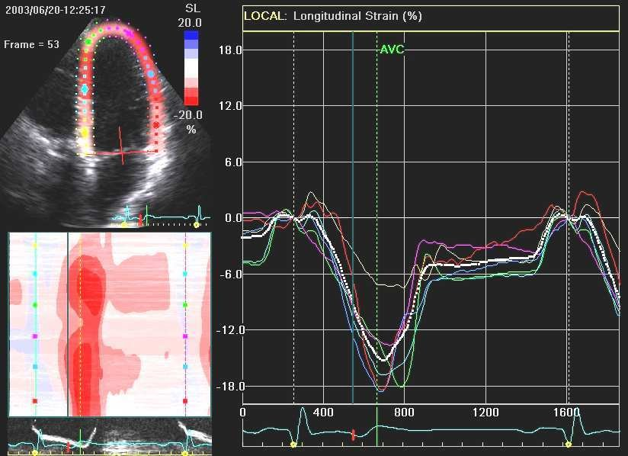
Question 2: The strain curves in this picture are LEAST likely to be which of the following?
The strain curves in this picture are LEAST likely to be which of the following?
Radial strain.
Longitudinal strain.
Circumferential strain.
B and C.
Notes:
Speckle tracking strain allows fast, semiautomated strain analysis. It also enables color-coded depiction of strain for easy interpretation of regional mechanics. Strain shortening or thickening (systole) is depicted in shades of red and lengthening or thinning (diastole) is depicted in shades of blue. In normal synchronous hearts, all segments will turn red simultaneously during systole and blue during diastole (Video 1). Answer A is the correct choice because radial strain reflects radial thickening and, hence, is a positive strain by convention. The strain depicted in Figure 1 is a negative strain. Answer B is an incorrect choice because longitudinal strain is negative in systole Answer C is an incorrect choice because circumferential strain is negative in systole. Answer D is an incorrect choice because both longitudinal and circumferential strain measures are negative (by convention) in systole.

Slide 9
Question 3: Which of the following is considered a normal global longitudinal strain (GLS) value?
- 14%
- 23%
Normal GLS value as indicated by the vendor
B and C.

Slide 10
Who requires imaging prior to therapy?
ASCO guidelines: Patients at elevated risk
Anthracycline (doxorubicin > 250 mg/m2)
Radiation therapy > 30 Gy
Combination therapy with lower doses
HER2 inhibitors
Cardiovascular risk factors
No guidelines yet:
Proteasome inhibitors
Tyrosine kinase inhibitors (risk depends on profile of inhibition)
VEGF inhibitors
Immune checkpoint inhibitors - ICIs
(Armenian, SH et al, J Clin Oncol, 2017, Lyon AR et al, Eur J Heart Fail, 2020)

Slide 11
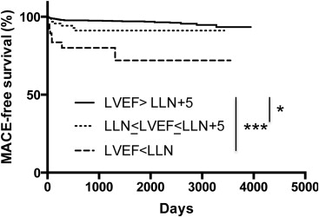
Baseline assessment: Does LVEF before therapy with anthracyclines predict the risk of MACE?
Wang et al, Am J Card, 2015
Notes:
The primary outcome was the subsequent occurrence of major adverse cardiac event (MACE) defined as either the New York Heart Association class III or IV congestive HF, cardiac arrest, or cardiac death
Cut off LVEF: women < 54%
Men < 52%
Five thousand fifty-seven patients were studied, of whom 124 (2.4%) developed MACE. Of the total cohort, 2,285 patients had an available echocardiogram pre-chemotherapy. Patients with MACE were older (p <0.0001), predominantly men (p = 0.03), and with a higher incidence of cardiovascular risk factors and cardiac treatments. Patients with hematologic cancers had a higher incidence of cardiac events than patients with breast cancer (4.2% vs 0.7%, p <0.0001). Baseline LVEF, LVEF ≤5 points above the lower limits of normal, and LV internal diameter were predictive of the rate of occurrence of MACE.

Slide 12
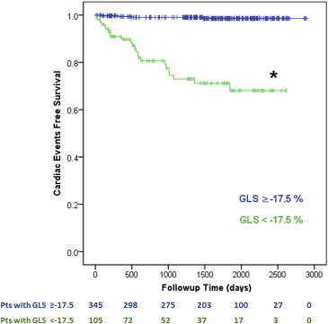
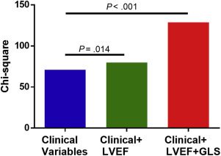
Baseline assessment-Addition of GLS to 2D EF increases the chi-Square
Wang et al, Am J Card, 2015
Notes:
Other strain:
Role of circumferential strain: under investigation, in particular, 1% difference in baselie strain correlated with a 31% increase in odds of cardiotoxicity
Patients with hematologic cancers treated with anthracyclines (450)
Six percent of patients with hematologic malignancies and anthracycline treatment developed CEs.
•Prechemotherapy LVEF and GLS were associated with subsequent CEs.
•GLS less than the absolute value of −17.5% was found in 23% of patients and associated with a sixfold increase in CEs.
•Baseline GLS improved on clinical variables and LVEF to identify later CEs.
symptomatic heart failure or cardiac death.
Incremental value of LVEF and GLS by nested logistic regression models in identifying subsequent CEs, presented as global χ² values. The addition of LVEF and GLS resulted in significant incremental improvement in the identification of CEs compared with the clinical risk factors

Slide 13
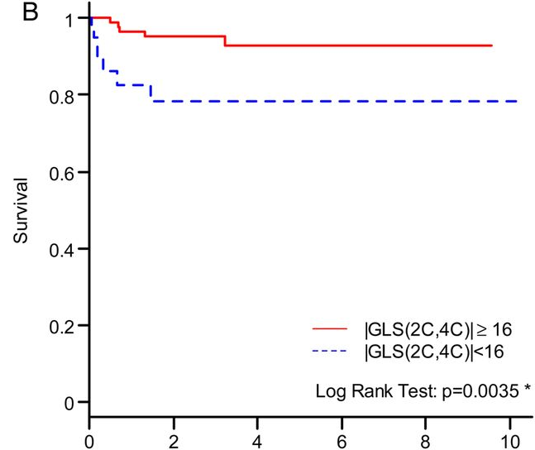
Baseline assessment: Global longitudinal strain as predictor MACE in Antracycline-based therapy in patients with borderline LVEF?
Patients with LLN < LVEF < LLN + 5%
Mousavi et al, Eur Heart J Cardiovasc Imaging, 2015
.
Notes:
Of 2234 patients undergoing echocardiography for pre-anthracycline assessment, 158 (7%) had a resting ejection fraction of 50-59%. Twelve patients experienced a MACE (congestive heart failure) at a median of 173 days (range: 15-530). Age, diabetes, previous coronary artery disease, LVEDV, indexed LVEDV, LVESV, indexed LVESV, and GLS were all predictive of MACE (P = 0.012, 0.039, 0.0029, 0.012, and 0.0065 for LVEDV, LVEDVI, LVESV, LVESVI, and GLS, respectively). Indexed LVEDV and GLS remained predictive of MACE when adjusted for age. Age and GLS were also predictive of overall mortality (P < 0.0001 and 0.0105, respectively).

Slide 14
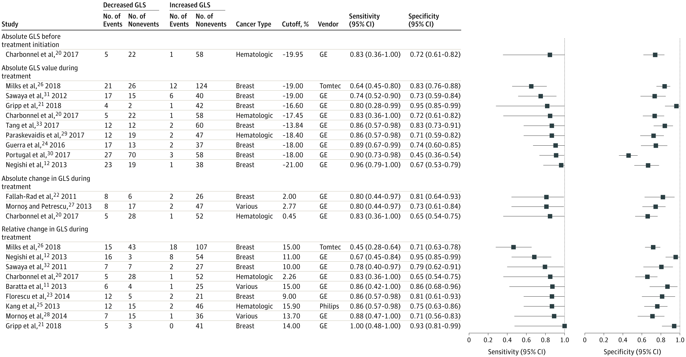
Baseline assessment of GLS - Meta-analysis: what is the cut-off?
Oikonomou et al, JAMA Cardiol. 2019;4(10):1007-1018
Notes:
Prognostic and Discriminatory Performance of Absolute Left Ventricular Global Longitudinal Strain (GLS) Measured After Initiation of Cardiotoxic Chemotherapy for Cancer Therapy–Related Cardiac Dysfunction A, Forest plot representing the odds ratios (ORs) for each reported cutoff value in each study as well as the overall summary ORs. Weights are taken from random-effects analysis. The estimated 95% prediction intervals for the overall summary OR are 7.03 to 21.42. GE indicates GE EchoPAC software (General Electric); and TomTec, 2D Cardiac Performance Analysis (TomTec Imaging Systems).

Slide 15
Question 1: Is a TTE indicated and what should be included?
All patients undergoing the chemotherapy with anthracyclines should have a baseline TTE.
The study should include an assessment of diastolic function because baseline diastolic dysfunction (Grade II or higher) increases the risk of MACE during chemotherapy with anthracycline.
The study should include an assessment of global longitudinal strain (GLS) because its addition to 2D LVEF significantly and incrementally improves the prediction of MACE compared with the clinical risk factors.
The study should include an assessment of circumferential stain because abnormal values have a high positive predictor value for MACE.

Slide 16
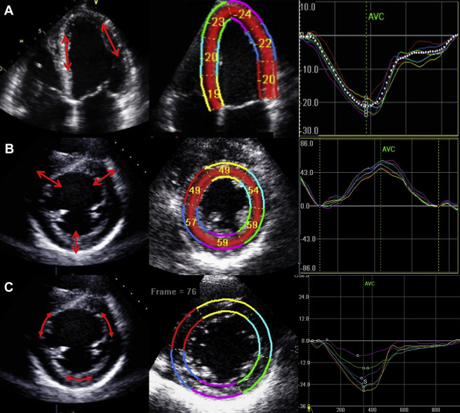
Question 2: The strain curves in this picture are LEAST likely to be which of the following?
The strain curves in this picture are LEAST likely to be which of the following?
Radial strain.
Longitudinal strain.
Circumferential strain.
B and C.
Thavendiranathan et al, 2014
Notes:
Speckle tracking strain allows fast, semiautomated strain analysis. It also enables color-coded depiction of strain for easy interpretation of regional mechanics. Strain shortening or thickening (systole) is depicted in shades of red and lengthening or thinning (diastole) is depicted in shades of blue. In normal synchronous hearts, all segments will turn red simultaneously during systole and blue during diastole (Video 1). Answer A is the correct choice because radial strain reflects radial thickening and, hence, is a positive strain by convention. The strain depicted in Figure 1 is a negative strain. Answer B is an incorrect choice because longitudinal strain is negative in systole Answer C is an incorrect choice because circumferential strain is negative in systole. Answer D is an incorrect choice because both longitudinal and circumferential strain measures are negative (by convention) in systole.

Slide 17
Question 3: Which of the following is considered a normal global longitudinal strain (GLS) value?
- 14%
- 20%
Normal GLS value as indicated by the vendor
B and C.

Slide 18
echocardiography in cardio-oncology
Surveillance during therapy

Slide 19
Case 2
Chief complaint: asymptomatic decline in LV function
right-sided breast cancer, cT2 N0 , Her2 +, ER/PR +, hypertension, S/p right-sided mastectomy and sentinel lymph node biopsy,
Undergoing neo-adjuvant therapy with APT regimen (Adjuvant Paclitaxel and Trastuzumab:
paclitaxel plus trastuzumab weekly for 12 weeks,
followed by 9 months of trastuzumab every 3 weeks.
After the first 12 weeks, a TTE is ordered:
2D LVEF has decreased from 61% to 49%,
GLS 14.5% (no previous reading).

Slide 20
Case 2
Other Medical History: Hypertension.
Age: 55
Gender: Female
VS: 154/85 mmHg, 74/min
Cardiac Exam: Normal heart sounds, no murmurs
Abdomen: Normal
Extremities: No edema

Slide 23
Question 4: How Often should repeat Surveillance studies be performed in patients DURING CARDIOTOXIC CHEMOTHERAPY ?
All patients on anthracycline-based chemotherapy should be imaged every 3 mos. There is no recommendation for Trastuzumab-based therapies.
A decline in LVEF by 15% to below LLN or in GLS by 10% is considered as cancer therapy related cardiac dysfunction (CTRCD).
Asymptomatic patients with CTRCD should be started on cardio-protective therapy and reimaged in 3 - 4 weeks.
In asymptomatic patients with CTRCD, repeat studies should be performed every 12 weeks.

Slide 24
Question 5: Which IMAGING modalities should BE performed IN SURVEILLANCE STUDIES?
Repeat assessment of LV function should be done by 2D imaging with contrast because it is less variable than imaging by 2D alone.
Repeat assessment by LV function can be done by 2D imaging with contrast or by 3D imaging because their temporal variability is comparable.
A change in LVEF by 3D imaging or by CMR is more likely to represent CTRCD than a change in 2D LVEF.
Changes in GLS can predict a subsequent decline in LVEF but whether this can be used for decision making regarding initiating cardioprotective therapy is unknown.

Slide 25
Surveillance during therapy-Who needs it?
ASCO GUIDELINES:
Repeat studies are recommended for symptomatic patients
Surveillance imaging may be offered during treatment in asymptomatic patients at increased risk.
Frequency should be determined based on clinical judgment and circumstances.
No recommendations regarding (dis)continuation on individuals with evidence for cardiac dysfunction.
HER2R inhibitors:
Imaging every three months
Armenian et al. J Clin Oncol. 2017; 35: 893-911.

Slide 26
Definition of cancer therapy-induced LV dysfunction
Society | Definition
CREC (1988) | Decline in LVEF of >10% to an LVEF of < 55%
HERA (2009) | Decline in LVEF of >10% to an LVEF of < 50%
BCIRG (2013) | Decline in LVEF of >10%
ASE/EACI (2014) | Decline in LVEF of >10% to an LVEF < 53% Decline in GLS > 15% subclinical LV dysfunction
ESC (2016) | Decline in LVEF of >10% to an LVEF below the lower limit of normal Decline in GLS > 15% may suggest risk of cardiotoxicity

Slide 27
Surveillance in Subclinical LV dysfunction
ASCO Guidelines:
Initiate guideline-based heart failure treatment
Close follow-up and repeat TTE
Discussion to delay next cycle of chemotherapy/modify therapy
Refer to cardio oncology clinic
Armenian et al. J Clin Oncol. 2017; 35: 893-911.

Slide 29
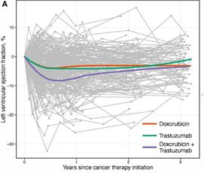
Change in LVEF with anthracycline or HER2 inhibitors
Doxorubicin and trastuzumab resulted in modest, persistent decline in LVEF at 3 years.
-3.8% versus -2.8%
The largest decline was seen with combination therapy: -6.6% at 1yr, partial recovery at 3 yrs
Narayan et al. Circulation. 2017

Slide 30
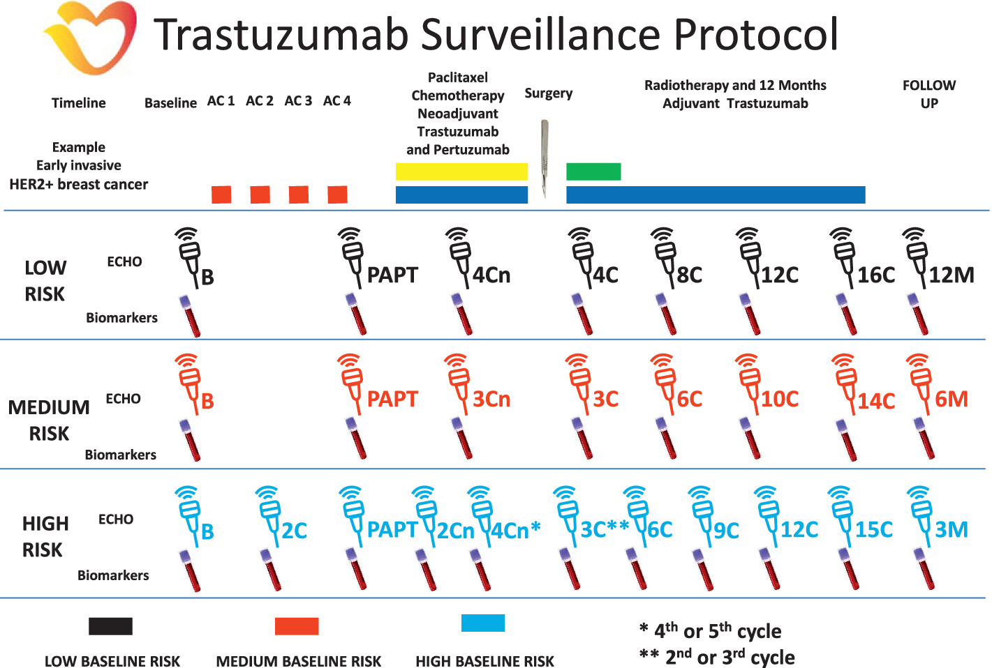
Celutkiene, European Journal of Heart Failure, 2020

Slide 31
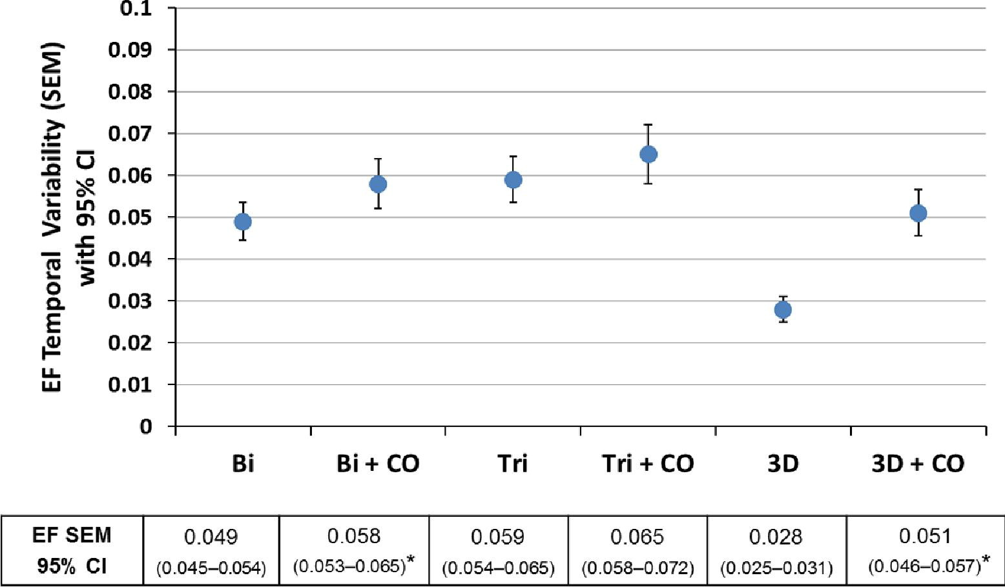
Reproducibility of echocardiographic techniques for sequential assessment of LVEF
56 patients with stable LV function by GLS were imaged 5 times over 12 mos
Thavendiranathan P et al, JACC, 2013

Slide 32
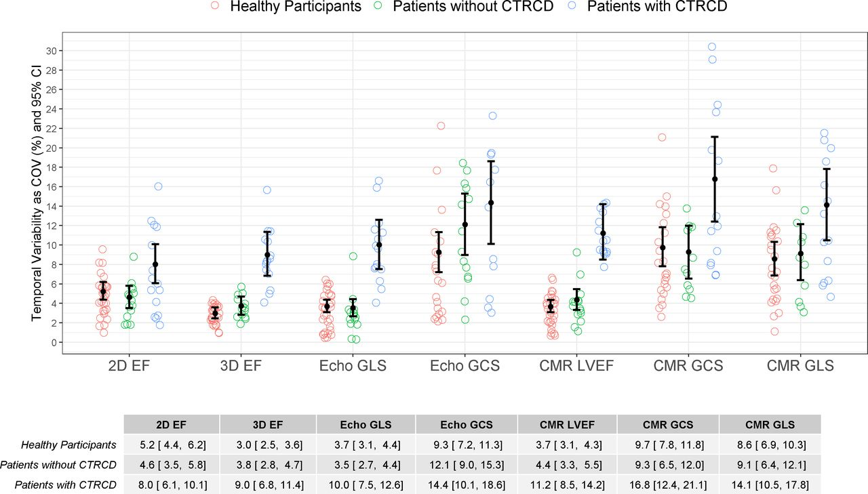
Comparison of temporal variability in CMR and echocardiography parameters in healthy volunteers against changes in women with HER2+ breast cancer with and without cancer therapy-related cardiotoxicity.
60 participants,
30 healthy volunteers,
30 cancer patients
15 + CTRCD,
Treated with doxo and trastuzumab,
3 CMR, TTE q 3mos
Lambert et al.
Heart 2020;106:817-823
Copyright © BMJ Publishing Group Ltd & British Cardiovascular Society. All rights reserved.

Slide 33
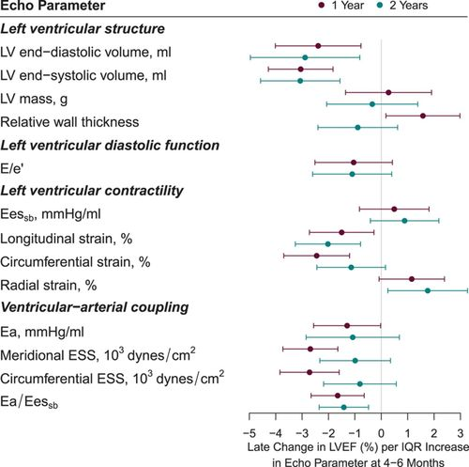
Changes in GLS are associated with CTRCD
Associations between early changes (4–6 mos) in echocardiographic parameters and subsequent changes in 2D LVEF (at 12 mos):
LV volumes, strain, and VA coupling were associated with subsequent changes in LVEF with doxorubicin and trastuzumab therapy.
Narayan et al. Circulation. 2017

Slide 34
Succour - GLS-Guided Management to prevent CTRCD
identify whether GLS-guided cardioprotective therapy prevents reduction in LVEF and development of CTRCD in high-risk patients compared with usual care
331 anthracycline-treated patients with another heart failure risk factor
initiation of cardioprotective therapy guided
by ≥12% relative reduction in GLS (n = 166) OR >10% absolute reduction of LVEF (n = 165)
Patients were followed for EF and development of CTRCD (symptomatic EF reduction of >5% or >10% asymptomatic to <55%) over 1 year.

Slide 35
Succour - GLS-Guided Management to prevent CTRCD
Primary outcome: change in LVEF was not significantly different between the 2 arms
Secondary outcomes:
significantly greater use of cardioprotective therapy (29% vs. 11%, p<0.0001)
fewer patients met CTRCD criteria in the GLS-guided than the EF-guided arm (5.8% vs. 13.7%; p = 0.02, NNT=13).
Thavendiranathan et al, JACC, 2021
Notes:
331 anthracycline-treated patients with another heart failure risk factor were randomly allocated to CPT initiation guided by either ≥12% relative reduction in GLS (n = 166) or >10% absolute reduction of LVEF (n = 165). Patients were followed for EF and development of CTRCD (symptomatic EF reduction of >5% or >10% asymptomatic to <55%) over 1 year.
At the 1-year follow-up, although the primary outcome of change in LVEF was not significantly different between the 2 arms, there was significantly greater use of CPT, and fewer patients met CTRCD criteria in the GLS-guided than the EF-guided arm (5.8% vs. 13.7%; p = 0.02), and the 1-year EF was 57 ± 6% versus 55 ± 7% (p = 0.05). Patients who received CPT in the EF-guided arm had a larger reduction in LVEF at follow-up than in the GLS-guided arm (9.1 ± 10.9% vs. 2.9 ± 7.4%; p = 0.03).
Although the change in LVEF was not different between the 2 arms as a whole, when patients who received CPT were compared, those in the GLS-guided arm had a significantly lower reduction in LVEF at 1 year follow-up. Furthermore, GLS-guided CPT significantly reduced a meaningful fall of LVEF to the abnormal range.

Slide 36
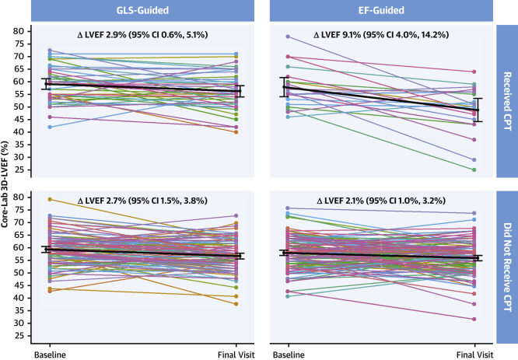
GLS-guided strategy does prevent decrement in LVEF in patients on cardioprotective therapy.
Thavendiranathan et al, JACC, 2021

Slide 37
Diastolic dysfunction as predictor of subsequent CTRCD
Mixed evidence and fewer studies
Worsening diastolic dysfunction during chemotherapy associated with 2-fold risk of CTRCD and subsequent reduction in LVEF
Upshaw et al. J Am Coll Cardiol Cardiovasc Imaging 2019

Slide 38
Question 4: How Often should repeat Surveillance studies be performed in patients DURING CARDIOTOXIC CHEMOTHERAPY ?
All patients on anthracycline-based chemotherapy should be imaged every 3 mos. There is no recommendation for Trastuzumab-based therapies.
A decline in LVEF by 15% to below LLN or in GLS by 10% is considered as cancer therapy related cardiac dysfunction (CTRCD).
Asymptomatic patients with CTRCD should be started on cardio-protective therapy and reimaged in 3 - 4 weeks.
In asymptomatic patients with CTRCD, repeat studies should be performed every 12 weeks.

Slide 39
Question 5: Which modalities should BE performed IN SURVEILLANCE STUDIES?
Repeat assessment of LV function should be done by 2D imaging with contrast because it is less variable than imaging by 2D alone.
Repeat assessment by LV function can be done by 2D imaging with contrast or by 3D imaging because their temporal variability is comparable.
A change in LVEF by 3D imaging or by CMR is more likely to represent CTRCD than a change in 2D LVEF.
Changes in GLS can predict a subsequent decline in LVEF but whether this can be used for decision making regarding initiating cardioprotective therapy is unknown.

Slide 40
echocardiography in cardio-oncology
Follow up after end of therapy

Slide 41
Case #3
Chief complaint: AML relapse, risk stratification prior to chemotherapy and allogeneic bone marrow transplant.
Past medical history: acute AML in 2009, induction with CALGB 10503 (7+3+3) 1/2009, Consolidation with HDAC + etoposide 3/2009, autologous bone marrow transplant 4/2009,
No TTE since 3/2009.
Other medical history: paroxysmal atrial fibrillation
Age: 57
Gender: Male
VS: 115/72 mmHg, 105/min
Cardiac exam: S1, S2, 2/6 SEM at left sternal border
Extremities: No edema

Slide 44
Question 6: Which statement is true regarding repEat imaging after completion of therapy?
Patients who received anthracycline should have a TTE within the first 12 mos after completion of therapy.
Patients who have completed HER2-therapy should have a TTE within the first 12 mos after completion of therapy and them every 5 years.
In anthracycline-induced cardiac dysfunction, the chance of recovering LVEF with guideline-based treatment is less than 30%.

Slide 45
TTE after end of therapy Who needs it and for how long?
Celutkiene J et al, Eur J Heart Fail. 2020

Slide 46
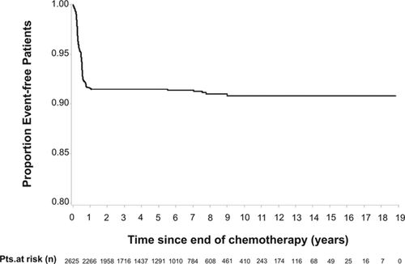
When does LV dysfunction occur after chemotherapy with anthracycline?
Cardinale D et al. Circulation, 2015
Notes:
Kaplan–Meier curve showing the cumulative incidence of cardiotoxicity in the study population. Pts. indicates patients.
Left ventricular ejection fraction (LVEF), at baseline, every 3 months during chemotherapy and for the following year, every 6 months over the following 4 years, and yearly afterward in a heterogeneous cohort of 2625 patients receiving anthracycline-containing therapy. In case of cardiotoxicity (LVEF decrease >10 absolute points, and <50%), heart failure therapy was initiated

Slide 47
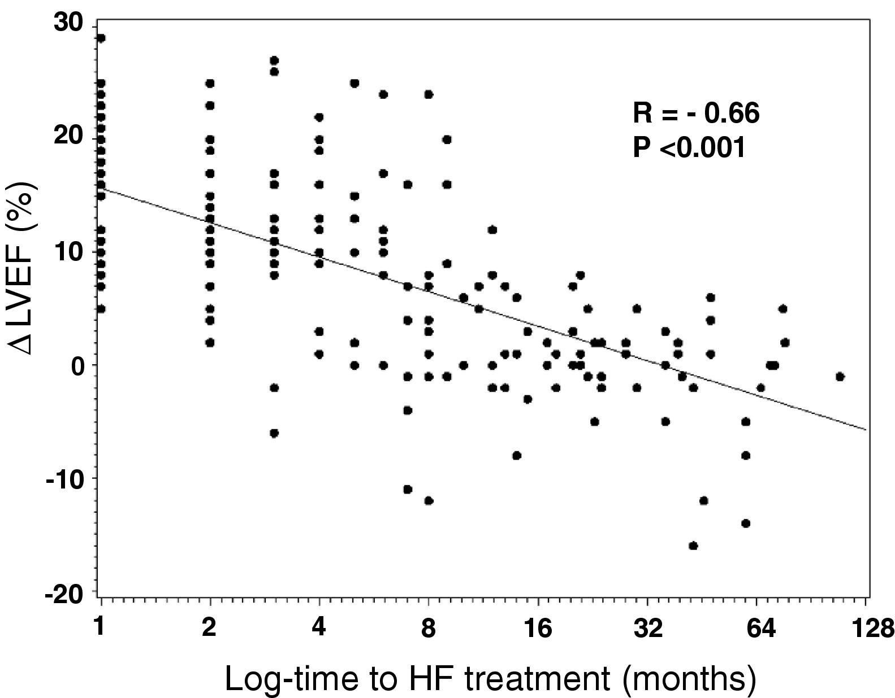
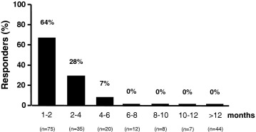
Early initiation of guideline-directed CHF treatment is associated with a better recovery of LV function
201 patients
TTE after end of chemotherapy
Median time from end of anthracycline therapy: 4 mos
Started on Enalapril/Carvedilol if LVEF < 45%
Percentage of Responders (recovery of LVEF) highest with shortest time to therapy
Cardinale D et al. JACC, 2010
Notes:
201 consecutive patients with a left ventricular ejection fraction (LVEF) ≤45% due to AC-CMP. Enalapril and, when possible, carvedilol were promptly initiated after detection of LVEF impairment. LVEF was measured at enrollment, every month for the first 3 months, every 3 months during the first 2 following years, and every 6 months afterward (mean follow-up 36 ± 27 months). Patients were considered responders, partial responders, or nonresponders according to complete, partial, or no recovery in LVEF, respectively.

Slide 48
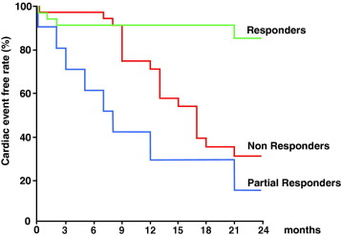
Recovery of LVEF after end of anthracycline therapy associated with event free survival
Cardinale D et al. JACC, 2010
Notes:
Patients with either partial or no LVEF increase after treatment experienced a more complicated clinical course, with a higher rate of cumulative cardiac events, including death, occurring more frequently in these 2 groups (Table 2).The cumulative cardiac event rate as a function of the follow-up time based on Kaplan-Meier estimates in the 3 groups is shown in Figure 2.

Slide 49
Question 6: Which statement is true regarding repEat imaging after completion of therapy?
Every patient who received anthracycline should have a TTE within the first 12 mos after completion of therapy.
Patients who have completed HER2-therapy should have a TTE within the first 12 mos after completion of therapy and then, every 5 years.
In anthracycline-induced cardiac dysfunction, the chance of recovering LVEF with guideline-based treatment is less than 30%

Slide 50
echocardiography in cardio-oncology
Pericardial disease
Valve disease
ICI-induced myocarditis

Slide 51
Case 3
65 yo man with recently diagnosed with metastatic melanoma
started on Nivolumab and Ipilimumab 12 days ago
c/o non-exertional left chest pain, fatigue, mild dyspnea
elevated CK (17,000 U/l) and troponin-I (4.7 ng/ml)
ECG: PR prolongation, no ST changes
TTE: EF 73%, no regional wall motion abnormalities
Diagnosis: myositis and myocarditis
Treatment: Methylprednisolone 1 mg/kg i.v.
24 h after admission, complete heart block
Develops refractory ventricular tachycardia
Johnson et al. N Engl J Med. 2016.

Slide 52
ICI-induced myocarditis
Clinical presentation:
Develops in the first weeks after start of treatment (~ day 40)
Is often accompanied by other symptoms, such as myositis
Heart failure symptoms are less common (50% have EF >50%)
Conduction disease, complete heart block, ventricular arrhythmias
Incidence
??? 0.1-5%, depending on criteria, higher with combination therapy
Outcome:
Major adverse cardiac endpoints (cardiovascular death, cardiac arrest, hemodynamically significant arrhythmias/heart block/cardiogenic shock) up to 50%;
Mortality 25-50%.
Mahmoud et al. J Am Coll Cardiol. 2018. Escudier et al. Circulation. 2017.

Slide 53
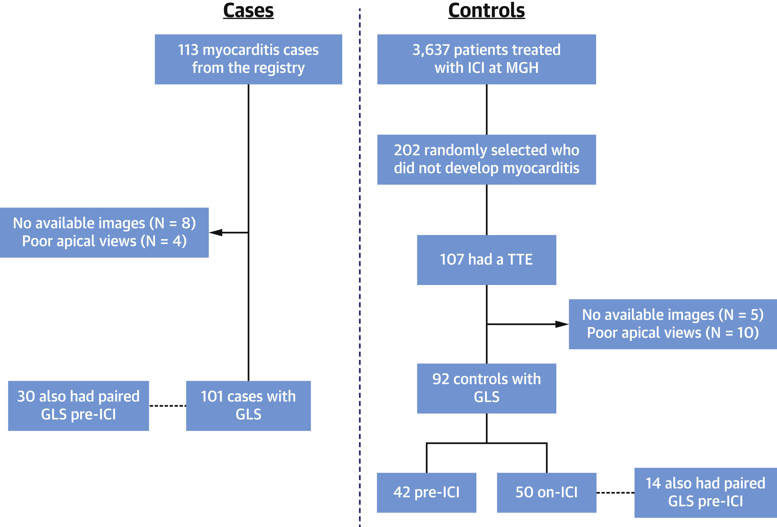
Is global longitudinal strain helpful in predicting ICI-myocarditis/MACE?
Awadalla et al, JACC, 2020
Notes:
evaluate the role of GLS and assess its association with cardiac events among patients with ICI myocarditis.
retrospectively compared echocardiographic GLS by speckle tracking at presentation with ICI myocarditis (cases, n = 101) to that from patients receiving an ICI who did not develop myocarditis (control subjects, n = 92). Where available, GLS was also measured pre-ICI in both groups. Major adverse cardiac events (MACE) were defined as a composite of cardiogenic shock, arrest, complete heart block, and cardiac death.
Pre-ICI, GLS was similar between cases and control subjects (20.3 ± 2.6% vs. 20.6 ± 2.0%; p = 0.60). There was no change in GLS among control subjects on an ICI without myocarditis (pre-ICI vs. on ICI, 20.6 ± 2.0% vs. 20.5 ± 1.9%; p = 0.41); in contrast, among cases, GLS decreased to 14.1 ± 2.8% (p < 0.001). The GLS at presentation with myocarditis was lower among cases presenting with either a reduced (12.3 ± 2.7%) or preserved EF (15.3 ± 2.0%; p < 0.001). Over a median follow-up of 162 days, 51 (51%) experienced MACE. The risk of MACE was higher with a lower GLS among patients with either a reduced or preserved EF. After adjustment for EF, each percent reduction in GLS was associated with a 1.5-fold increase in MACE among patients with a reduced EF (hazard ratio: 1.5; 95% confidence interval: 1.2 to 1.8) and a 4.4-fold increase with a preserved EF (hazard ratio: 4.4; 95% confidence interval: 2.4 to 7.8).
major adverse cardiac events (MACE), defined, as previously (3), as a composite of cardiovascular death, cardiac arrest, cardiogenic shock, and hemodynamically significant complete heart block. In cases where cardiac arrest, cardiogenic shock, or complete heart block led to death, that case was counted as a cardiac death.

Slide 54
GLS to predict ICI-myocarditis?
Awadalla et al, JACC, 2020
Notes:
Conclusions: GLS decreases with ICI myocarditis and, compared with control subjects, was lower among cases presenting with either a preserved or reduced EF. Lower GLS was strongly associated with MACE in ICI myocarditis presenting with either a preserved or reduced EF.

Slide 55
Reduced GLS is associated with MACE (Regardless of LVEF)
Awadalla et al, JACC, 2020

Slide 56
Limitations in the field
Limited data on cancer therapies other than anthracycline and trastuzumab
Small study sizes
Little data on “hard outcomes’, i.e. how echo-guided therapy impacts on CHF, death or interruption of therapy

Slide 57
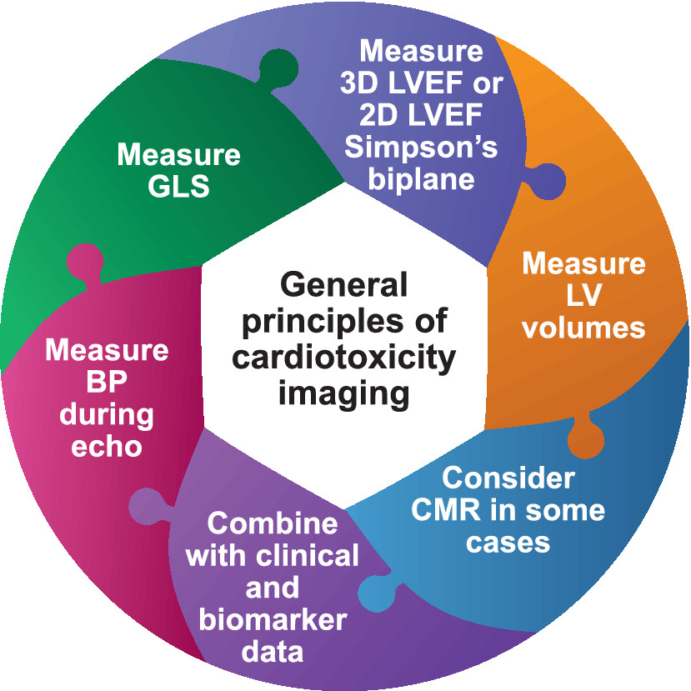

Slide 58
Thank you
Good luck!

Slide 59
Assessment of Prognostic Value of Left Ventricular Global Longitudinal Strain for Early Prediction of Chemotherapy-Induced Cardiotoxicity: A Systematic Review and Meta-analysis

